Slide 1

Are we Really That Different?
Ori Rinaman
Bellevue University

Slide 2

Liberal vs Conservative

Slide 3

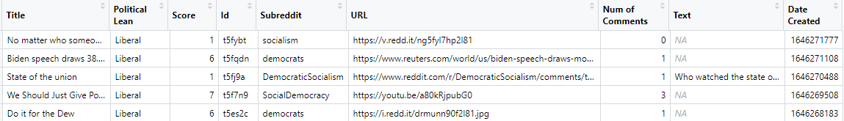
The Data
Title: Title of the topic discussed
Political Lean: Liberal or Conservative
Score: Number of up votes
ID: Distinct Reddit ID
Subreddit: Separate communities on discord with similar interests
URL: Link attached to post
Number of Comments: Number of comments on each post
Text: Body of text with the post
Date Created: Date the post was created

Slide 4
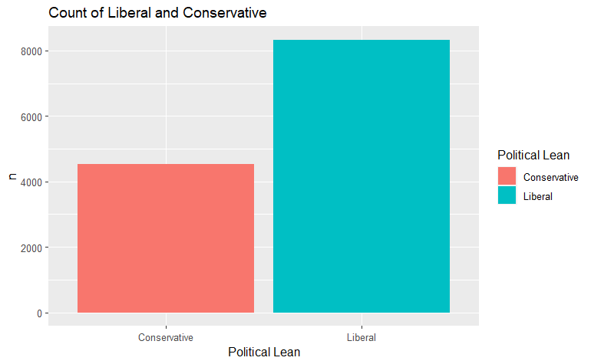
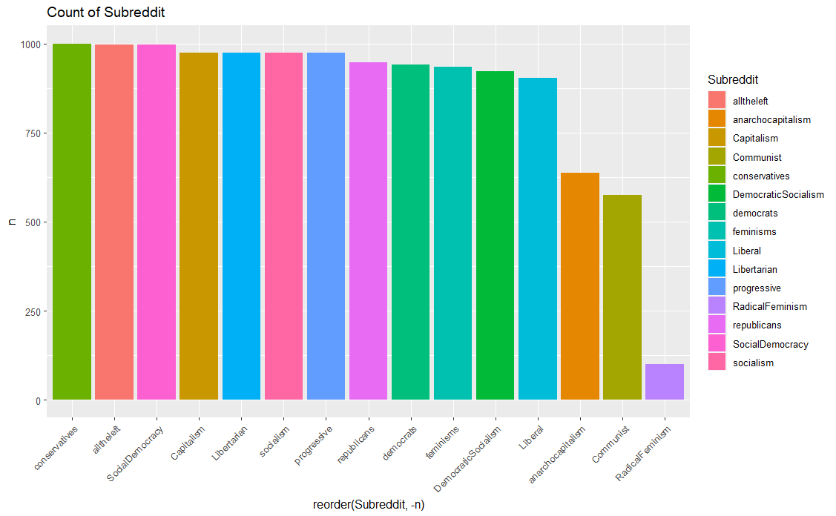
The Data

Slide 5
Cleaning the Data
Standardizing
The dog is happy!
the dog is happy
the
dog
is
happy
Tokenization
the dog is happy
Remove Stop Words
the
dog
is
happy
dog
happy

Slide 6
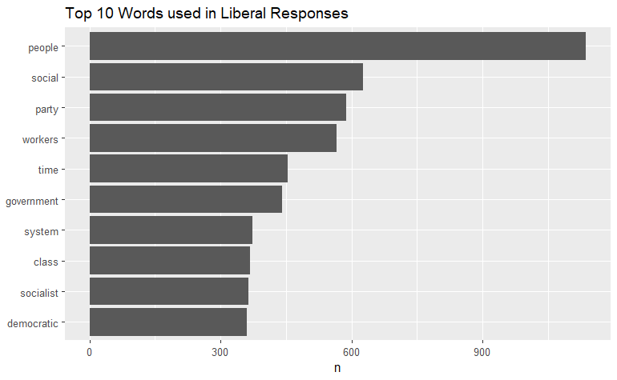
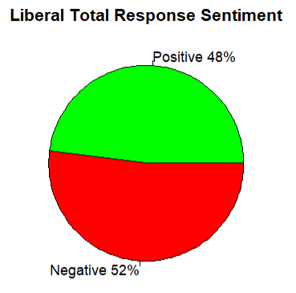
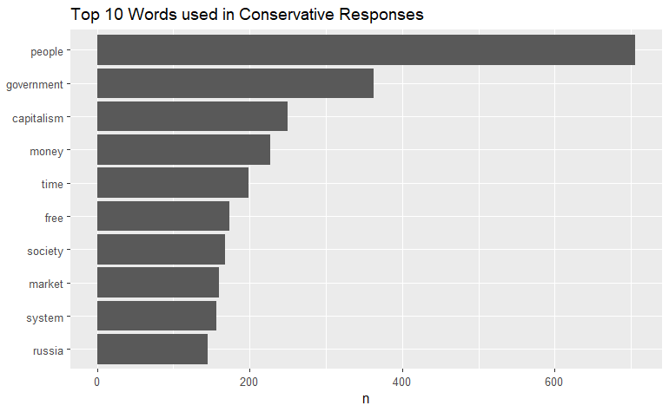
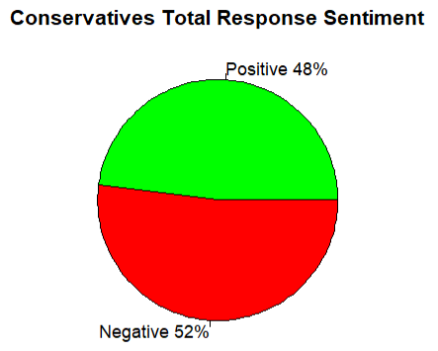
How Groups Respond Overall

Slide 7
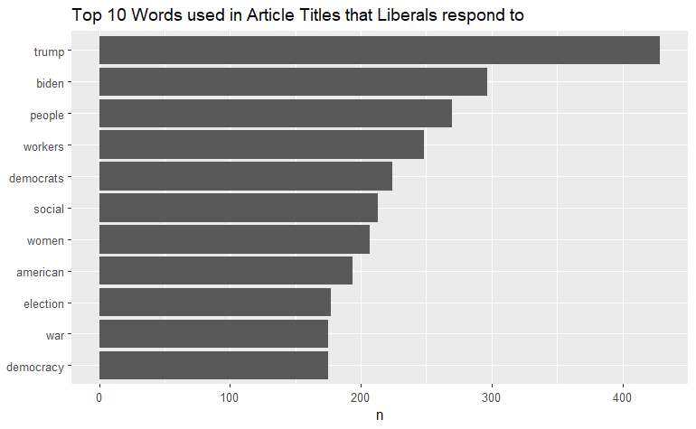
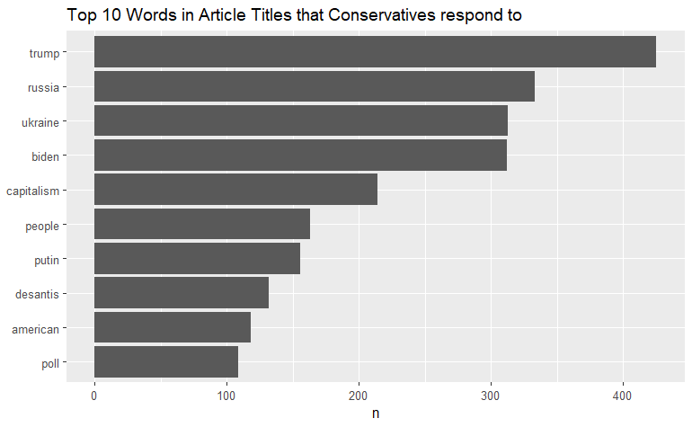
Articles that groups are responding to

Slide 8
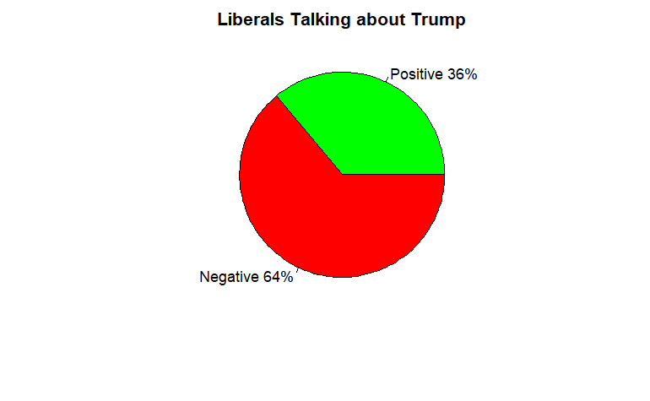
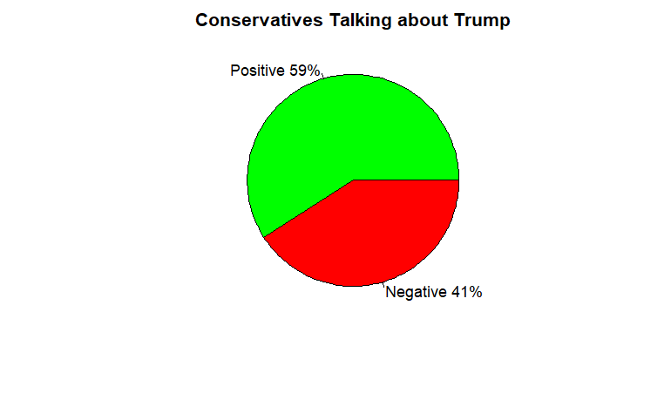
“trump” Sentiment

Slide 9
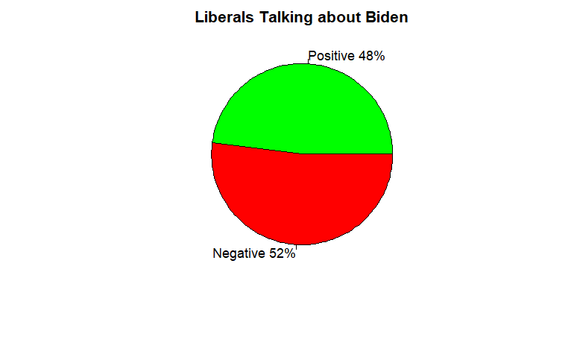
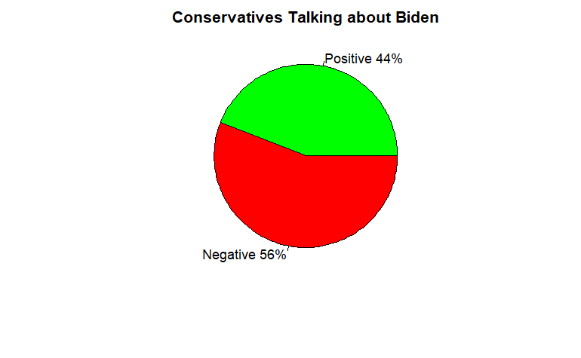
“Biden”

Slide 10
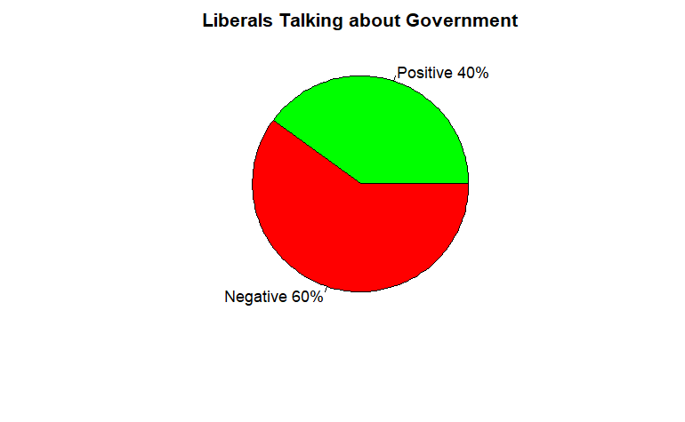

GOVERNMENT

Slide 11
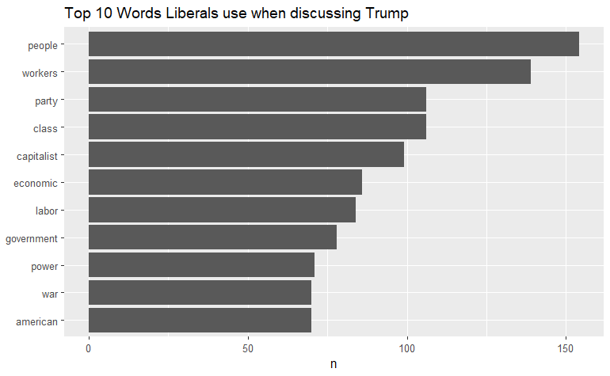
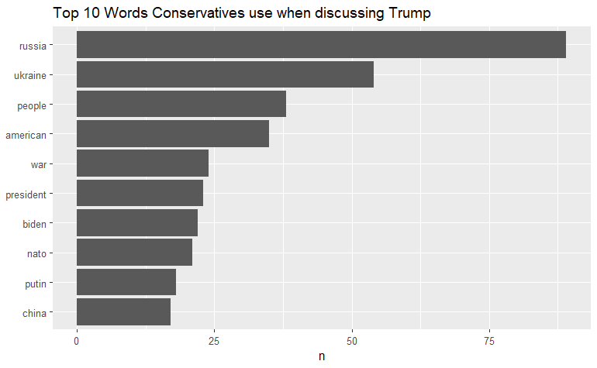
“TRUMP”

Slide 12





NEXT STEPS
N-grams
Expand Dataset
Twitter
Facebook
Instagram
News Website Comments such as FOX/CNN/MSNBC/ABC

Slide 13
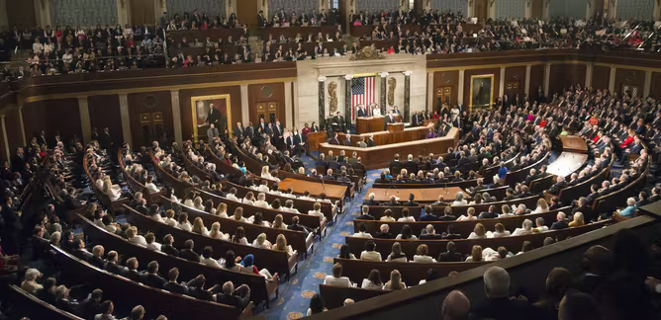
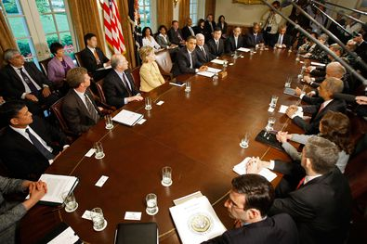

FUTURE USES/ADDITIONAL Applications

Slide 14
ETHICS

Slide 15
Thank you

Slide 16
References
Conservative vs liberal. Diffen. (n.d.). Retrieved April 3, 2022, from https://www.diffen.com/difference/Conservative_vs_Liberal
Gajare, N. (2022, March 28). Liberals vs conservatives on reddit [13000 posts]. Kaggle. Retrieved April 3, 2022, from https://www.kaggle.com/datasets/neelgajare/liberals-vs-conservatives-on-reddit-13000-posts
Gersema, Emily. “Why Is America so Divided?” USC News, 23 Nov. 2021, https://news.usc.edu/194874/why-is-america-divided/.
Silge, J., & Robinson, D. (2017). Text mining with R: A tidy approach. O'Reilly.
United States: Country Profile.” Freedom House, https://freedomhouse.org/country/united-states.

